Slide 1
Optimisation
Optimisations of baseline SIR model for the 3 different start points.
For the original SIR model we can optimise:
Relaxing to beta2=0.258 only in phase 4 [DONE]
Relaxing to beta2=0.258 in phases 3,4
Relaxing to beta2=0.258 in phases 2, 3, 4
SIRS Phase 2+3 intervention duration optimisation:
Explore optimising the intervention duration for the 4 different scenarios RWC, and the previous 3 scenarios (phase 2 beta1: 0.064, 0.032 and 0)
Explore the effect of optimising the SIRS model with differing trigger days (75, 100 and 125)

Slide 2
85-15 pop. structure

Slide 3
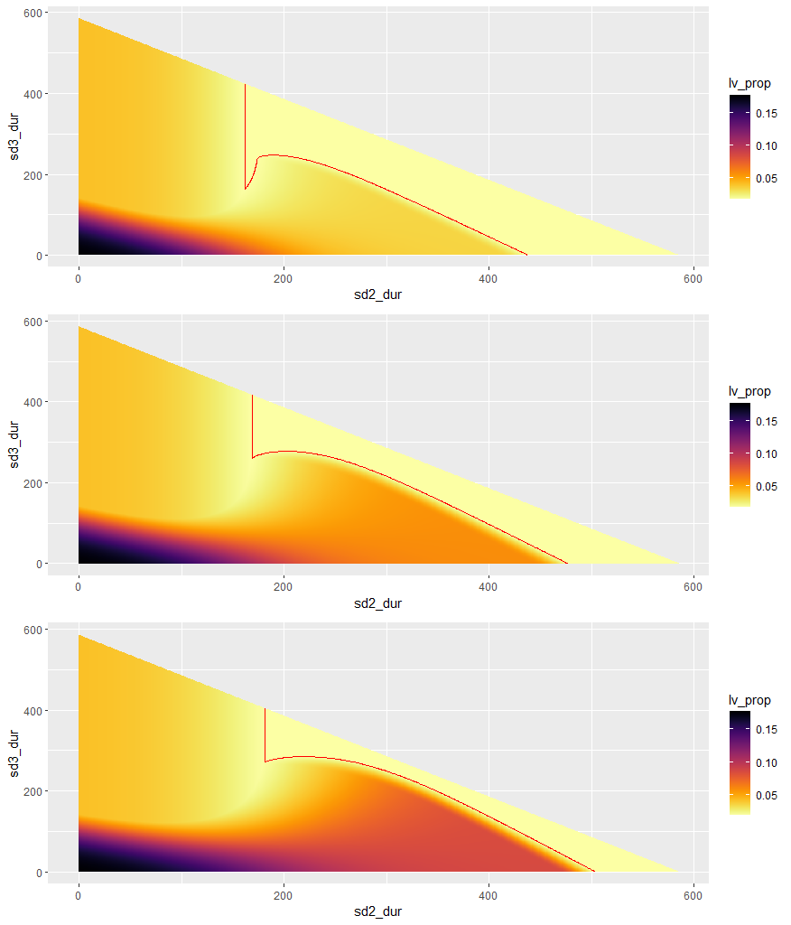
Baseline:
R₀ = 2.4
T₂ = 4.6
Red line in graphs show the value of Iv(100)=0.01825.
Phase 0 = 100 days
Phase 1 = 6 weeks
Phase | beta1 | beta2
0 | 0.161 | 0.161
1 | 0.064 | 0.064
2 | 0.064 | 0.161
3 | 0.161 | 0.161
4 | 0.258 | 0.258
Phase | beta1 | beta2
0 | 0.161 | 0.161
1 | 0.064 | 0.064
2 | 0.032 | 0.161
3 | 0.161 | 0.161
4 | 0.258 | 0.258
Phase | beta1 | Beta2
0 | 0.161 | 0.161
1 | 0.064 | 0.064
2 | 0.0 | 0.161
3 | 0.161 | 0.161
4 | 0.258 | 0.258

Slide 4
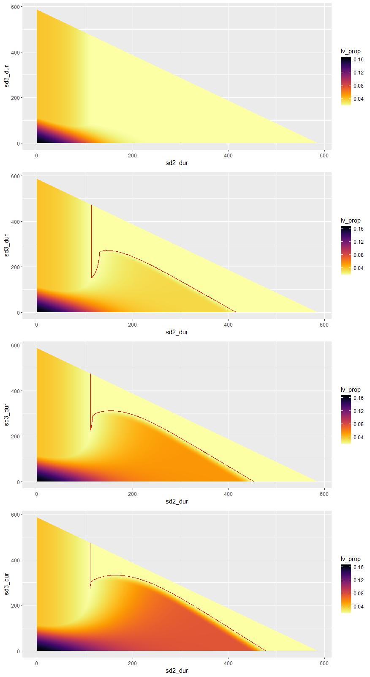
Phase | beta1 | beta2
0 | 0.161 | 0.161
1 | 0.097 | 0.097
2 | 0.097 | 0.161
3 | 0.161 | 0.161
4 | 0.258 | 0.258
RWC:
R₀ = 2.4
T₂ = 4.6
Red line in graphs show the value of Iv(100)=0.01825.
Phase 0 = 100 days
Phase 1 = 6 weeks
Phase | beta1 | beta2
0 | 0.161 | 0.161
1 | 0.097 | 0.097
2 | 0.064 | 0.161
3 | 0.161 | 0.161
4 | 0.258 | 0.258
Phase | beta1 | beta2
0 | 0.161 | 0.161
1 | 0.097 | 0.097
2 | 0.032 | 0.161
3 | 0.161 | 0.161
4 | 0.258 | 0.258
Phase | beta1 | beta2
0 | 0.161 | 0.161
1 | 0.097 | 0.097
2 | 0.0 | 0.161
3 | 0.161 | 0.161
4 | 0.258 | 0.258

Slide 5
80-20 pop. structure
SIR-model

Slide 6
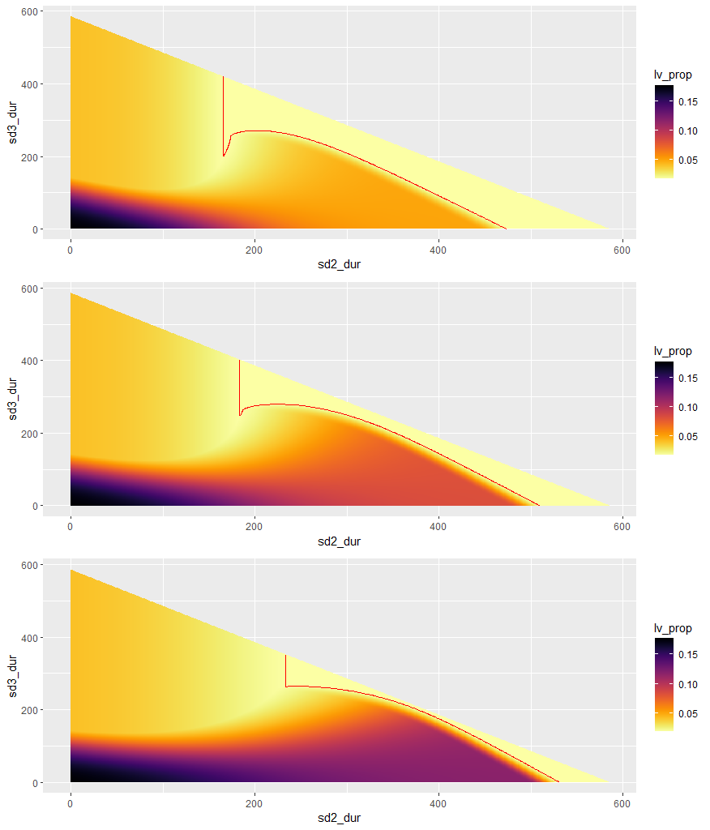
Baseline:
R₀ = 2.4
T₂ = 4.6
Red line in graphs show the value of Iv(100)=0.01825.
Phase 0 = 100 days
Phase 1 = 6 weeks
Phase | beta1 | beta2
0 | 0.161 | 0.161
1 | 0.064 | 0.064
2 | 0.064 | 0.161
3 | 0.161 | 0.161
4 | 0.258 | 0.258
Phase | beta1 | beta2
0 | 0.161 | 0.161
1 | 0.064 | 0.064
2 | 0.032 | 0.161
3 | 0.161 | 0.161
4 | 0.258 | 0.258
Optimal durations:
Scenario | Duration phase 2 | Duration phase 3
1 | 167 | 208
2 | 184 | 251
3 | 235 | 265
Phase | beta1 | Beta2
0 | 0.161 | 0.161
1 | 0.064 | 0.064
2 | 0.0 | 0.161
3 | 0.161 | 0.161
4 | 0.258 | 0.258

Slide 7
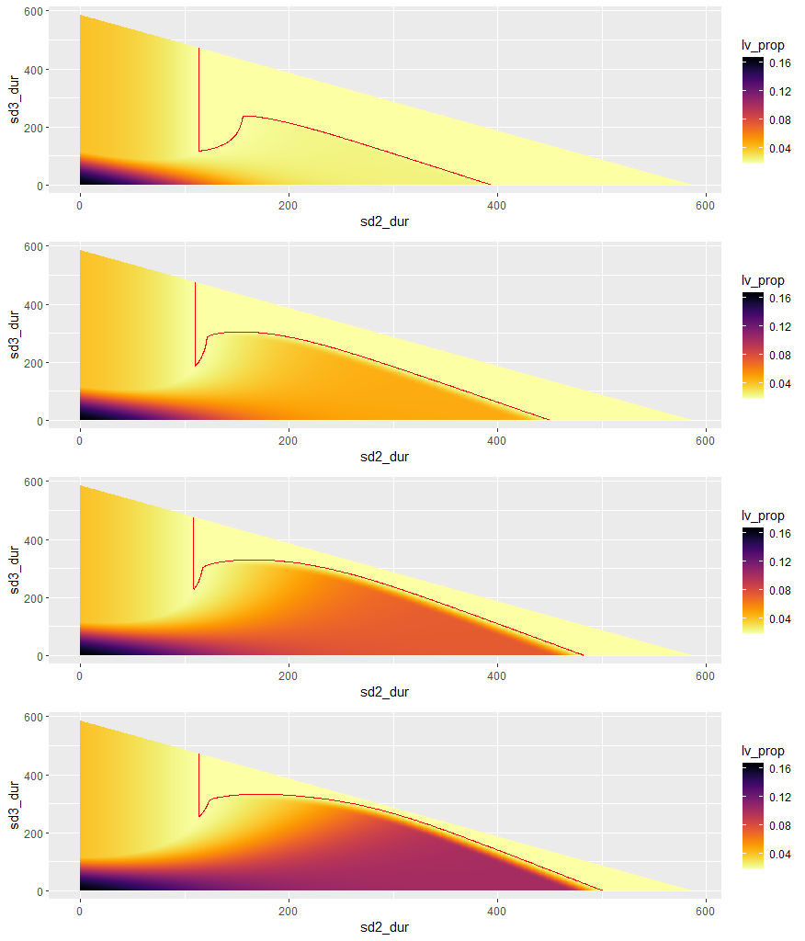
Phase | beta1 | beta2
0 | 0.161 | 0.161
1 | 0.097 | 0.097
2 | 0.097 | 0.161
3 | 0.161 | 0.161
4 | 0.258 | 0.258
RWC:
R₀ = 2.4
T₂ = 4.6
Red line in graphs show the value of Iv(100)=0.01825
Phase 0 = 100 days
Phase 1 = 6 weeks
Phase | beta1 | beta2
0 | 0.161 | 0.161
1 | 0.097 | 0.097
2 | 0.064 | 0.161
3 | 0.161 | 0.161
4 | 0.258 | 0.258
Phase | beta1 | beta2
0 | 0.161 | 0.161
1 | 0.097 | 0.097
2 | 0.032 | 0.161
3 | 0.161 | 0.161
4 | 0.258 | 0.258
Optimal durations:
Scenario | Duration phase 2 | Duration phase 3
1 | 114 | 118
2 | 110 | 189
3 | 109 | 231
4 | 115 | 261
Phase | beta1 | beta2
0 | 0.161 | 0.161
1 | 0.097 | 0.097
2 | 0.0 | 0.161
3 | 0.161 | 0.161
4 | 0.258 | 0.258

Slide 8
80-20 pop. structure
SIRS-model

Slide 9
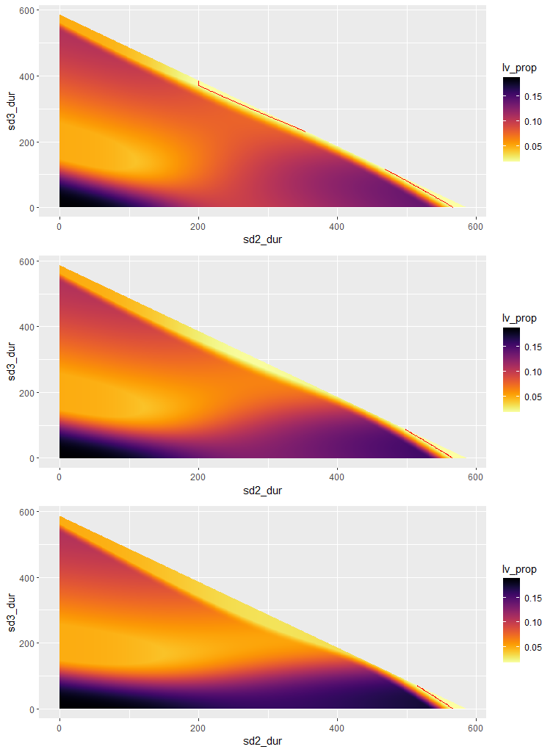
Baseline:
R₀ = 2.4
T₂ = 4.6
Red line in graphs show the value of Iv(100)=0.01825
Phase 0 = 100 days
Phase 1 = 6 weeks
Phase | beta1 | beta2
0 | 0.161 | 0.161
1 | 0.064 | 0.064
2 | 0.064 | 0.161
3 | 0.161 | 0.161
4 | 0.258 | 0.258
Phase | beta1 | beta2
0 | 0.161 | 0.161
1 | 0.064 | 0.064
2 | 0.032 | 0.161
3 | 0.161 | 0.161
4 | 0.258 | 0.258
Optimal durations:
Scenario | Duration phase 2 | Duration phase 3
1 | 200 | 371
2 | 493 | 92
3 | 512 | 73
Phase | beta1 | Beta2
0 | 0.161 | 0.161
1 | 0.064 | 0.064
2 | 0.0 | 0.161
3 | 0.161 | 0.161
4 | 0.258 | 0.258

Slide 10
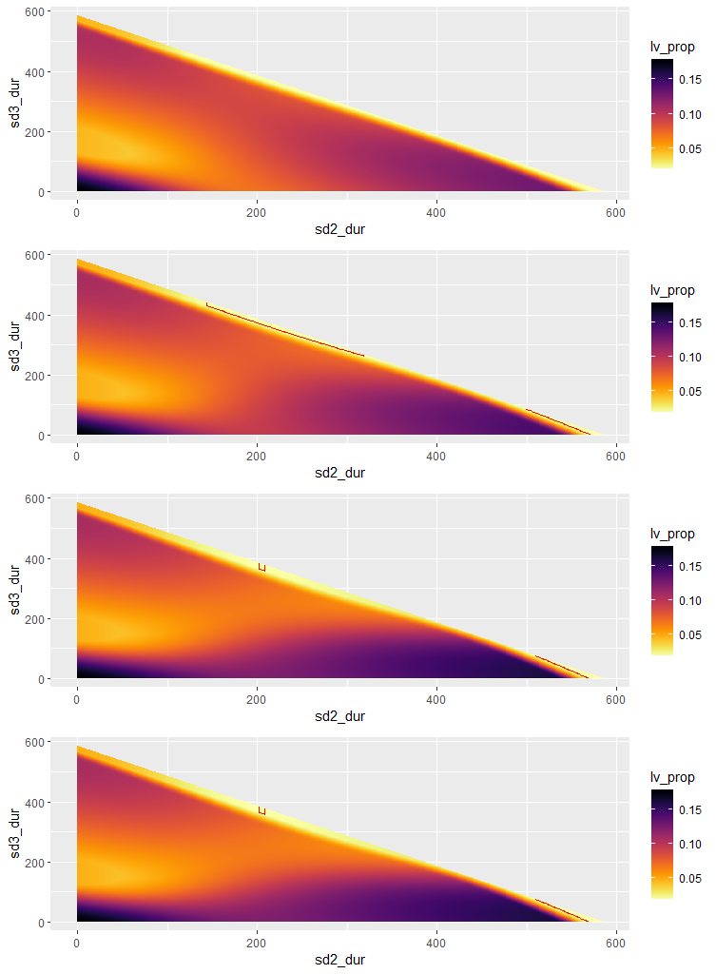
Phase | beta1 | beta2
0 | 0.161 | 0.161
1 | 0.097 | 0.097
2 | 0.097 | 0.161
3 | 0.161 | 0.161
4 | 0.258 | 0.258
RWC:
R₀ = 2.4
T₂ = 4.6
Red line in graphs show the value of Iv(100)=
Phase 0 = 100 days
Phase 1 = 6 weeks
Phase | beta1 | beta2
0 | 0.161 | 0.161
1 | 0.097 | 0.097
2 | 0.064 | 0.161
3 | 0.161 | 0.161
4 | 0.258 | 0.258
Phase | beta1 | beta2
0 | 0.161 | 0.161
1 | 0.097 | 0.097
2 | 0.032 | 0.161
3 | 0.161 | 0.161
4 | 0.258 | 0.258
Optimal durations:
Scenario | Duration phase 2 | Duration phase 3
1 | NA | NA
2 | 144 | 430
3 | 202 | 365
4 | 511 | 74
Phase | beta1 | beta2
0 | 0.161 | 0.161
1 | 0.097 | 0.097
2 | 0.0 | 0.161
3 | 0.161 | 0.161
4 | 0.258 | 0.258

Slide 11
Different starting points
SIR-model

Slide 12
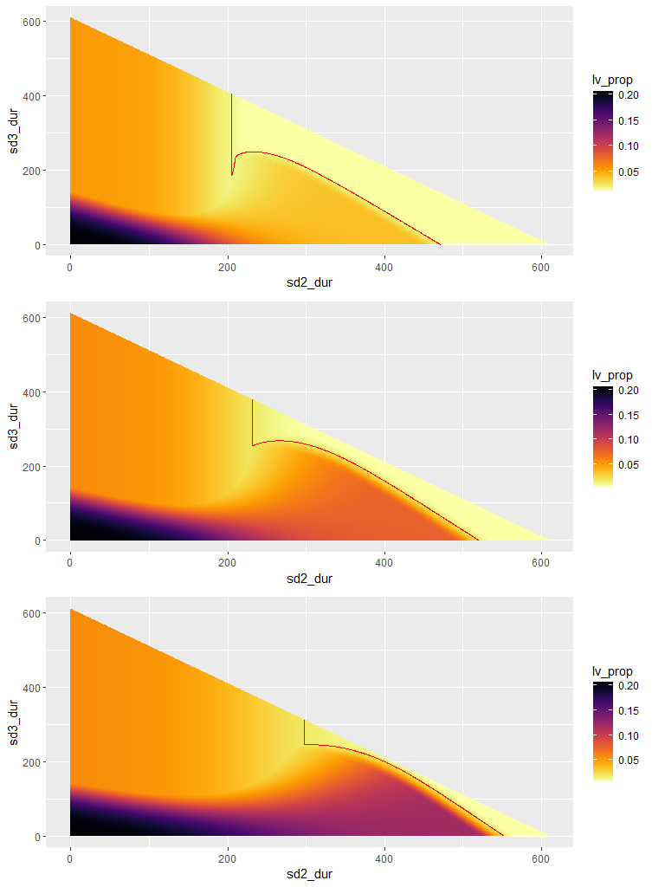
Baseline simulations:
Starting day phase 1: t=75
Baseline:
R₀ = 2.4
T₂ = 4.6
Red line in graphs show the value of 0.01825
Phase 0 = 75 days
Phase 1 = 6 weeks
Phase | beta1 | beta2
0 | 0.161 | 0.161
1 | 0.064 | 0.064
2 | 0.064 | 0.161
3 | 0.161 | 0.161
4 | 0.258 | 0.258
Phase | beta1 | beta2
0 | 0.161 | 0.161
1 | 0.064 | 0.064
2 | 0.032 | 0.161
3 | 0.161 | 0.161
4 | 0.258 | 0.258
Optimal durations:
Scenario | Duration phase 2 | Duration phase 3
1 | 205 | 187
2 | 232 | 255
3 | 298 | 246
Phase | beta1 | Beta2
0 | 0.161 | 0.161
1 | 0.064 | 0.064
2 | 0.0 | 0.161
3 | 0.161 | 0.161
4 | 0.258 | 0.258

Slide 13
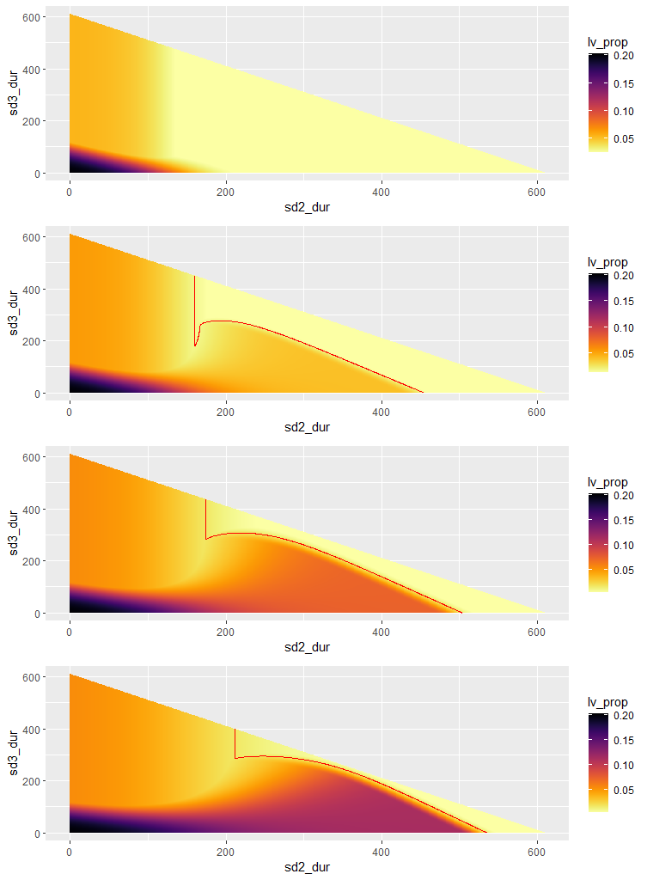
Phase | beta1 | beta2
0 | 0.161 | 0.161
1 | 0.097 | 0.097
2 | 0.097 | 0.161
3 | 0.161 | 0.161
4 | 0.258 | 0.258
RWC simulations:
Starting day phase 1: t=75
R₀ = 2.4
T₂ = 4.6
Red line in graphs show the value of 0.01825
Phase 0 = 75 days
Phase 1 = 6 weeks
Phase | beta1 | beta2
0 | 0.161 | 0.161
1 | 0.097 | 0.097
2 | 0.064 | 0.161
3 | 0.161 | 0.161
4 | 0.258 | 0.258
Phase | beta1 | beta2
0 | 0.161 | 0.161
1 | 0.097 | 0.097
2 | 0.032 | 0.161
3 | 0.161 | 0.161
4 | 0.258 | 0.258
Optimal durations:
Scenario | Duration phase 2 | Duration phase 3
1 | NA | NA
2 | 160 | 180
3 | 174 | 283
4 | 211 | 286
Phase | beta1 | beta2
0 | 0.161 | 0.161
1 | 0.097 | 0.097
2 | 0.0 | 0.161
3 | 0.161 | 0.161
4 | 0.258 | 0.258

Slide 14
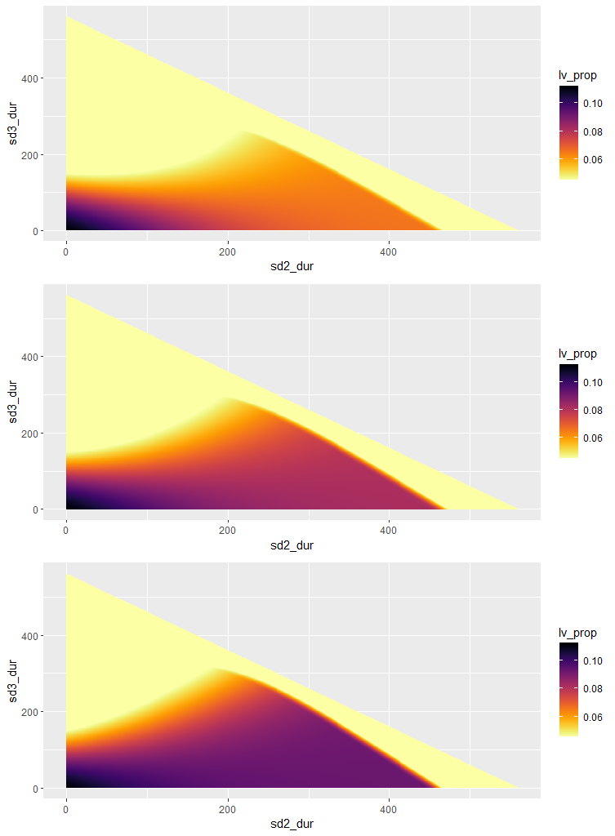
Baseline simulations:
Starting day phase 1: t=125
Baseline:
R₀ = 2.4
T₂ = 4.6
Red line in graphs show the value of 0.01285
Phase 0 = 125 days
Phase 1 = 6 weeks
Phase | beta1 | beta2
0 | 0.161 | 0.161
1 | 0.064 | 0.064
2 | 0.064 | 0.161
3 | 0.161 | 0.161
4 | 0.258 | 0.258
Phase | beta1 | beta2
0 | 0.161 | 0.161
1 | 0.064 | 0.064
2 | 0.032 | 0.161
3 | 0.161 | 0.161
4 | 0.258 | 0.258
Optimal durations:
Scenario | Duration phase 2 | Duration phase 3
1 | NA | NA
2 | NA | NA
3 | NA | NA
Phase | beta1 | Beta2
0 | 0.161 | 0.161
1 | 0.064 | 0.064
2 | 0.0 | 0.161
3 | 0.161 | 0.161
4 | 0.258 | 0.258

Slide 15
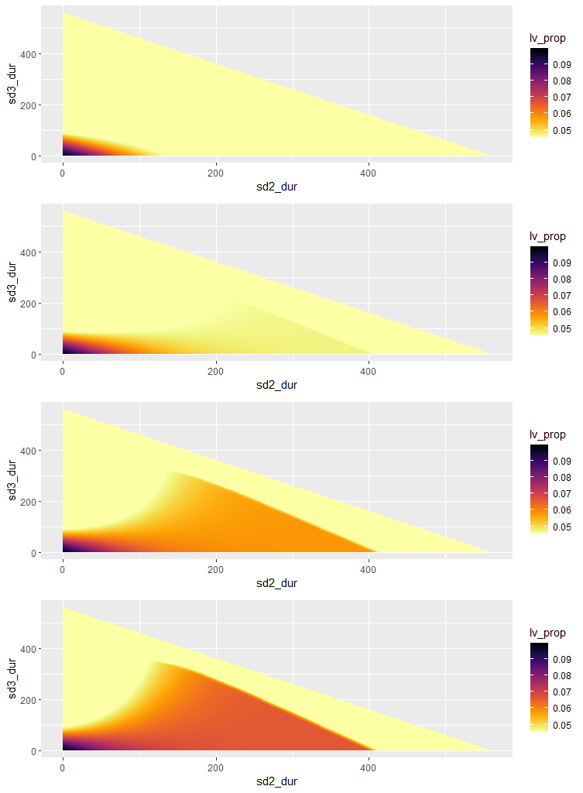
Phase | beta1 | beta2
0 | 0.161 | 0.161
1 | 0.097 | 0.097
2 | 0.097 | 0.161
3 | 0.161 | 0.161
4 | 0.258 | 0.258
RWC simulations:
Starting day phase 1: t=125
R₀ = 2.4
T₂ = 4.6
Red line in graphs show the value of 0.01825
Phase 0 = 125 days
Phase 1 = 6 weeks
Phase | beta1 | beta2
0 | 0.161 | 0.161
1 | 0.097 | 0.097
2 | 0.064 | 0.161
3 | 0.161 | 0.161
4 | 0.258 | 0.258
Phase | beta1 | beta2
0 | 0.161 | 0.161
1 | 0.097 | 0.097
2 | 0.032 | 0.161
3 | 0.161 | 0.161
4 | 0.258 | 0.258
Optimal durations:
Scenario | Duration phase 2 | Duration phase 3
1 | NA | NA
2 | NA | NA
3 | NA | NA
4 | NA | NA
Phase | beta1 | beta2
0 | 0.161 | 0.161
1 | 0.097 | 0.097
2 | 0.0 | 0.161
3 | 0.161 | 0.161
4 | 0.258 | 0.258

Slide 16
Different starting points
SIRS-model

Slide 17
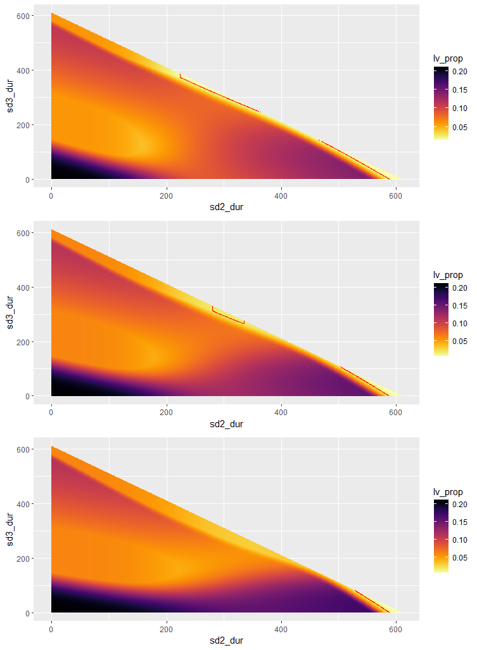
Baseline simulations:
Starting day phase 1: t=75
Baseline:
R₀ = 2.4
T₂ = 4.6
Red line in graphs show the value of 0.01825
Phase 0 = 75 days
Phase 1 = 6 weeks
Phase | beta1 | beta2
0 | 0.161 | 0.161
1 | 0.064 | 0.064
2 | 0.064 | 0.161
3 | 0.161 | 0.161
4 | 0.258 | 0.258
Phase | beta1 | beta2
0 | 0.161 | 0.161
1 | 0.064 | 0.064
2 | 0.032 | 0.161
3 | 0.161 | 0.161
4 | 0.258 | 0.258
Optimal durations:
Scenario | Duration phase 2 | Duration phase 3
1 | 224 | 374
2 | 280 | 313
3 | 527 | 83
Phase | beta1 | Beta2
0 | 0.161 | 0.161
1 | 0.064 | 0.064
2 | 0.0 | 0.161
3 | 0.161 | 0.161
4 | 0.258 | 0.258

Slide 18
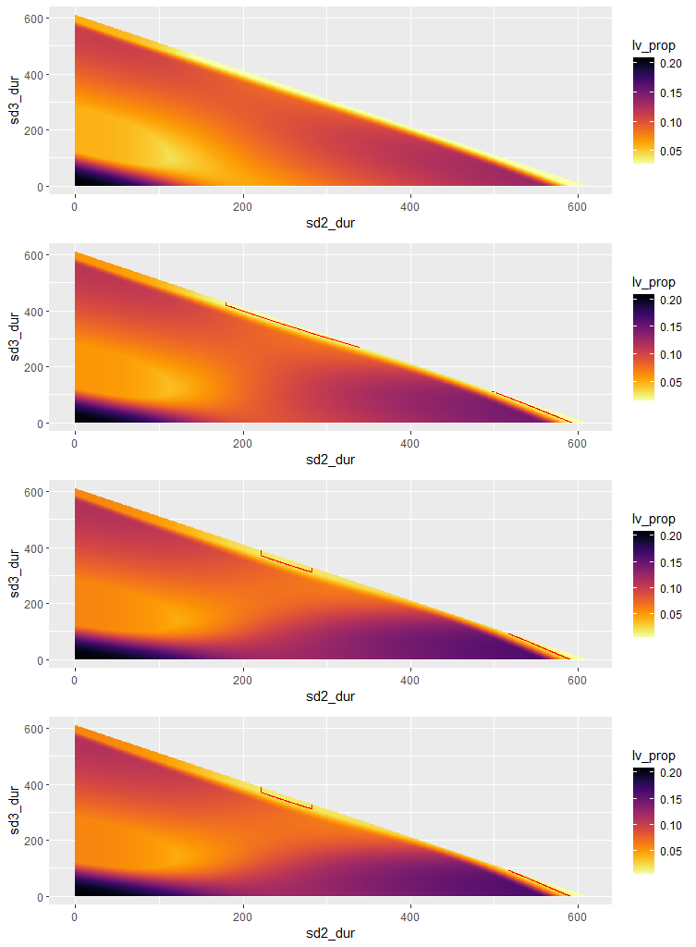
Phase | beta1 | beta2
0 | 0.161 | 0.161
1 | 0.097 | 0.097
2 | 0.097 | 0.161
3 | 0.161 | 0.161
4 | 0.258 | 0.258
RWC simulations:
Starting day phase 1: t=75
R₀ = 2.4
T₂ = 4.6
Red line in graphs show the value of 0.01825
Phase 0 = 75 days
Phase 1 = 6 weeks
Phase | beta1 | beta2
0 | 0.161 | 0.161
1 | 0.097 | 0.097
2 | 0.064 | 0.161
3 | 0.161 | 0.161
4 | 0.258 | 0.258
Phase | beta1 | beta2
0 | 0.161 | 0.161
1 | 0.097 | 0.097
2 | 0.032 | 0.161
3 | 0.161 | 0.161
4 | 0.258 | 0.258
Optimal durations:
Scenario | Duration phase 2 | Duration phase 3
1 | NA | NA
2 | 180 | 420
3 | 221 | 372
4 | 529 | 81
Phase | beta1 | beta2
0 | 0.161 | 0.161
1 | 0.097 | 0.097
2 | 0.0 | 0.161
3 | 0.161 | 0.161
4 | 0.258 | 0.258

Slide 19
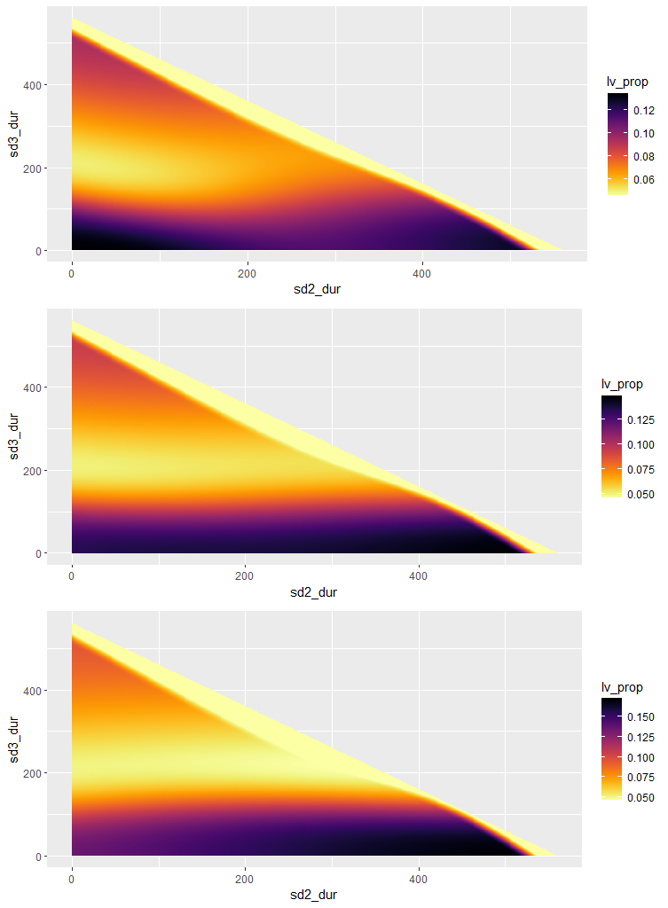
Baseline simulations:
Starting day phase 1: t=125
Baseline:
R₀ = 2.4
T₂ = 4.6
Red line in graphs show the value of 0.01825
Phase 0 = 125 days
Phase 1 = 6 weeks
Phase | beta1 | beta2
0 | 0.161 | 0.161
1 | 0.064 | 0.064
2 | 0.064 | 0.161
3 | 0.161 | 0.161
4 | 0.258 | 0.258
Phase | beta1 | beta2
0 | 0.161 | 0.161
1 | 0.064 | 0.064
2 | 0.032 | 0.161
3 | 0.161 | 0.161
4 | 0.258 | 0.258
Optimal durations:
Scenario | Duration phase 2 | Duration phase 3
1 | NA | NA
2 | NA | NA
3 | NA | NA
Phase | beta1 | Beta2
0 | 0.161 | 0.161
1 | 0.064 | 0.064
2 | 0.0 | 0.161
3 | 0.161 | 0.161
4 | 0.258 | 0.258

Slide 20
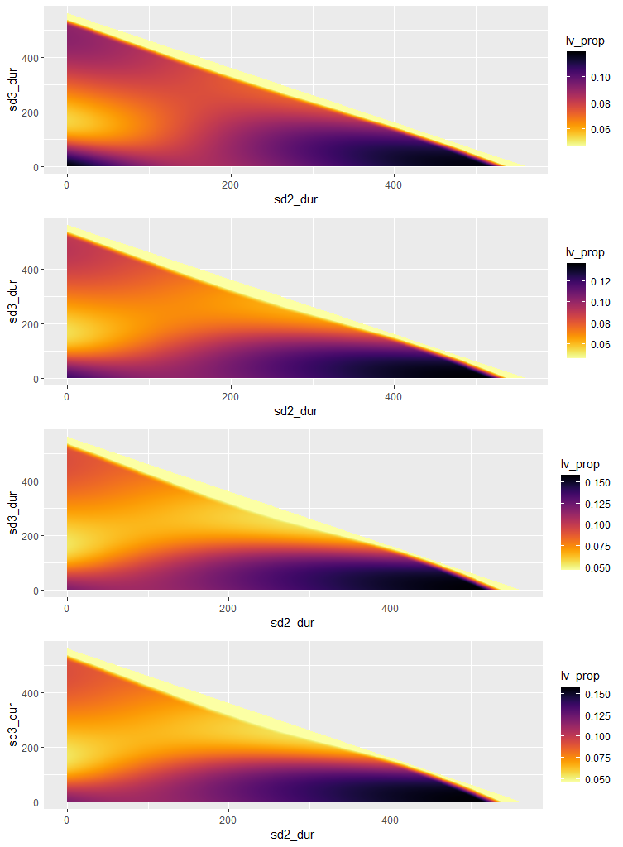
Phase | beta1 | beta2
0 | 0.161 | 0.161
1 | 0.097 | 0.097
2 | 0.097 | 0.161
3 | 0.161 | 0.161
4 | 0.258 | 0.258
RWC simulations:
Starting day phase 1: t=125
R₀ = 2.4
T₂ = 4.6
Red line in graphs show the value of 0.01825
Phase 0 = 125 days
Phase 1 = 6 weeks
Phase | beta1 | beta2
0 | 0.161 | 0.161
1 | 0.097 | 0.097
2 | 0.064 | 0.161
3 | 0.161 | 0.161
4 | 0.258 | 0.258
Phase | beta1 | beta2
0 | 0.161 | 0.161
1 | 0.097 | 0.097
2 | 0.032 | 0.161
3 | 0.161 | 0.161
4 | 0.258 | 0.258
Optimal durations:
Scenario | Duration phase 2 | Duration phase 3
1 | NA | NA
2 | NA | NA
3 | NA | NA
4 | NA | NA
Phase | beta1 | beta2
0 | 0.161 | 0.161
1 | 0.097 | 0.097
2 | 0.0 | 0.161
3 | 0.161 | 0.161
4 | 0.258 | 0.258

Slide 21
Relaxing beta2

Slide 22
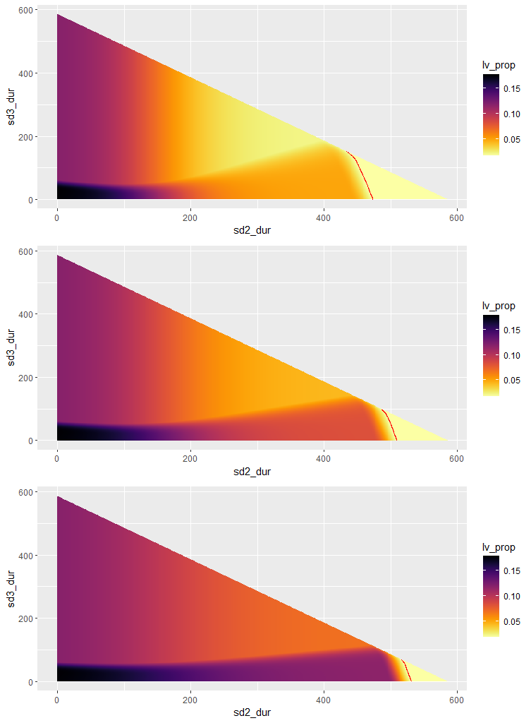
Phase | beta1 | beta2
0 | 0.161 | 0.161
1 | 0.064 | 0.064
2 | 0.064 | 0.161
3 | 0.161 | 0.258
4 | 0.258 | 0.258
Relax phase 3+4
Phase | beta1 | beta2
0 | 0.161 | 0.161
1 | 0.064 | 0.064
2 | 0.032 | 0.161
3 | 0.161 | 0.258
4 | 0.258 | 0.258
Optimal durations:
Scenario | Duration phase 2 | Duration phase 3
1 | 434 | 151
2 | 486 | 99
3 | 515 | 70
Phase | beta1 | Beta2
0 | 0.161 | 0.161
1 | 0.064 | 0.064
2 | 0.0 | 0.161
3 | 0.161 | 0.258
4 | 0.258 | 0.258

Slide 23
